Slide 1
“Shag Rug” Planting by Danny Coffey of Boulevard Cypress Cuttings on a Stone
June 22, 2022

Slide 2
What You Need
Multiple cuttings grown in bonsai mix close together in a container for at least 2 years
Stone on which to plant cuttings
Muck (see slide for photo of brand used)
Copper bonsai wire (12 gauge) for –
  Tie-down loops (see slide for photo of example)
Quick-drying epoxy putty to cement tie-down loops to stone
Aluminum bonsai wire (2.0 mm) for –
  Tie-down wires
  “Hair Pins” (see slide for photo of example)
Screened akadama fines
Screened sphagnum moss
Collected live moss
Water hose

Slide 3
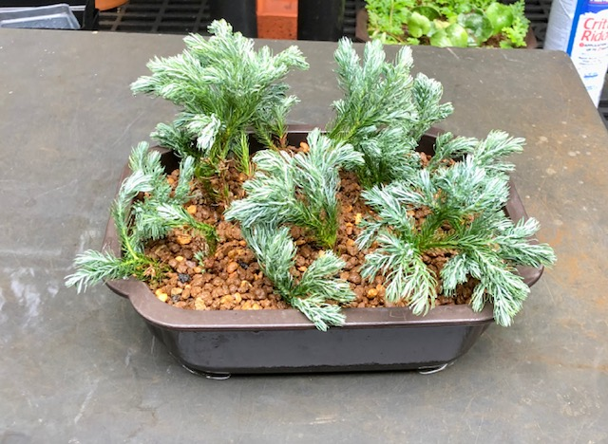
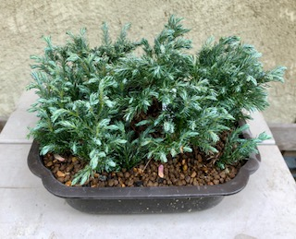
Cuttings stuck on July 10, 2020 in bonsai mix of akadama, pumice and lava rock
July 10, 2020
May 2, 2021

Slide 4
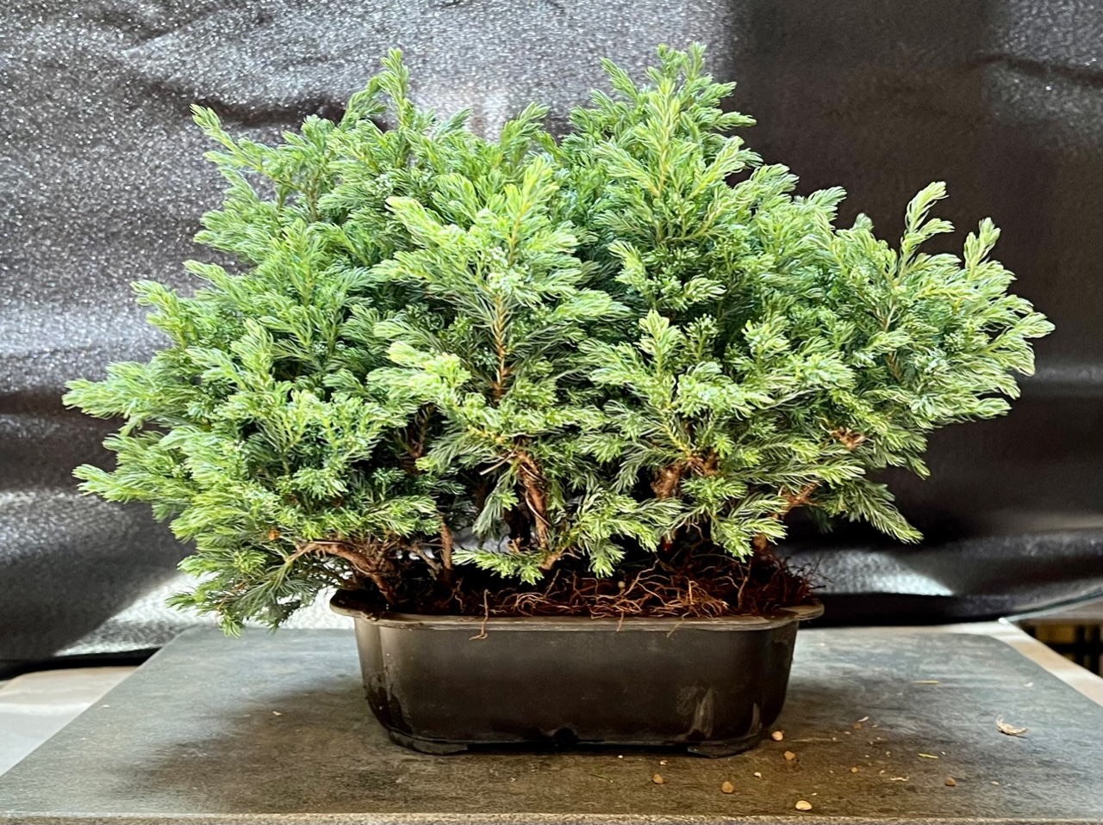
Boulevard Cypress Cuttings -- June 22, 2022
Ready for planting on a stone.
The roots of the cuttings had grown tightly together in the pot over past 2 years.

Slide 5
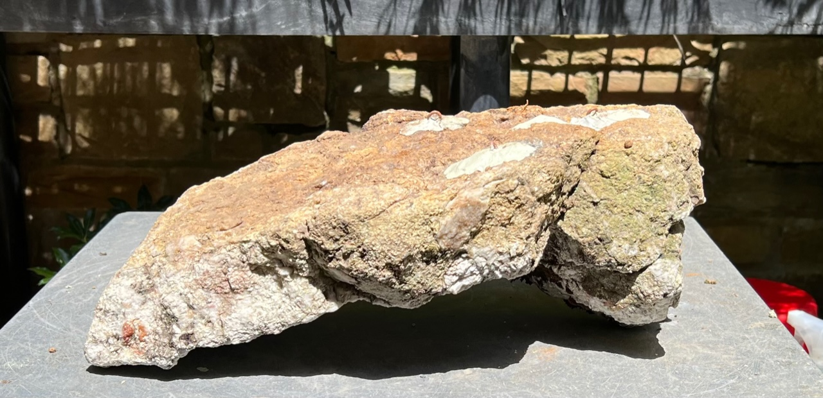
Stone to be used for planting
(Collected by Sage Smith)

Slide 6
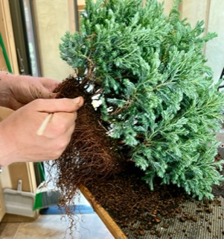
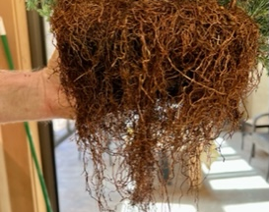
Preparing Roots
Use chopstick to untangle roots
Cut very few roots because repotting was riskier being done in June rather than in early spring when roots could be safely cut back

Slide 7
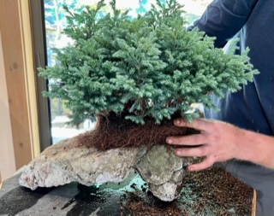
Checking Fit of Roots to Stone

Slide 8
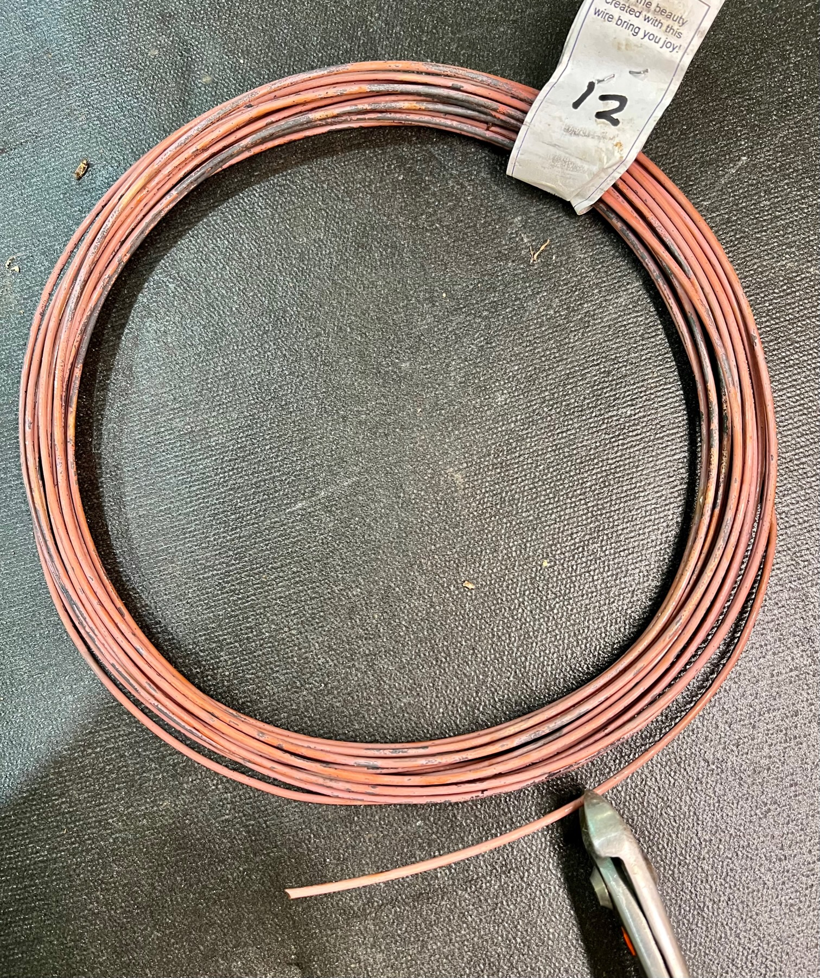
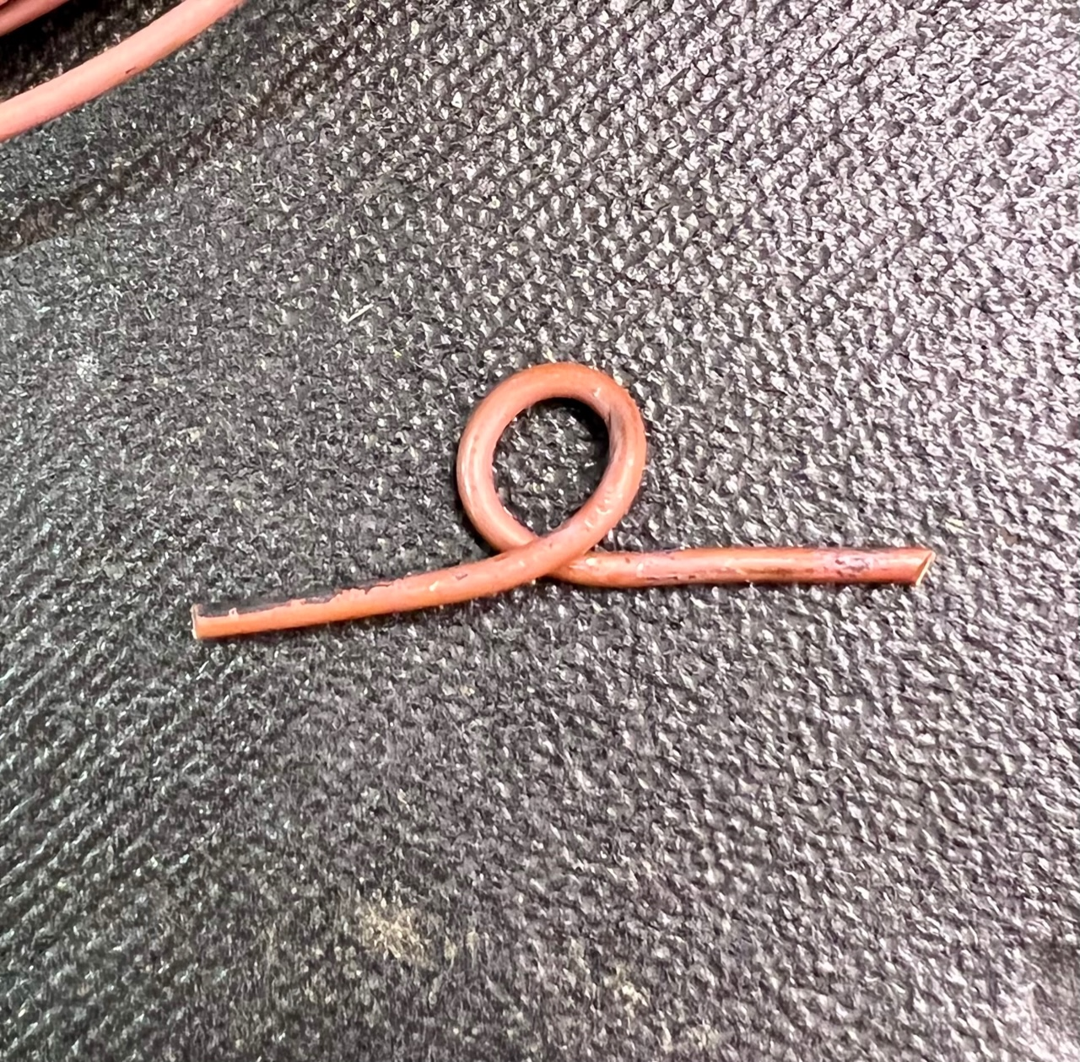
Making Tie-Down Eye Loops
Cut 3” pieces of 12 gauge copper wire
Twist to make a closed loop to be cemented into crack

Slide 9
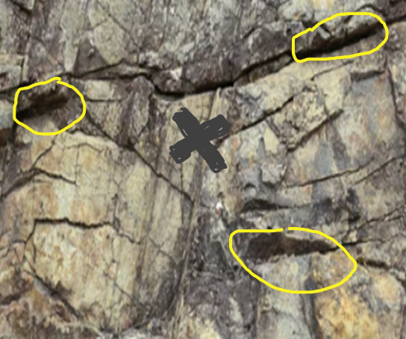
Attaching Eye Loops to the Stone
Oatey epoxy putty was used to cement in place 3 copper eye loops to hold tie-down wires
In this example of a stone surface, with the “X” marking the intended center of the rooted cuttings, the circled areas are good locations to place the eye-loops. Once cemented, the uneven surface in those areas will help hold the eye-loop in place.

Slide 10
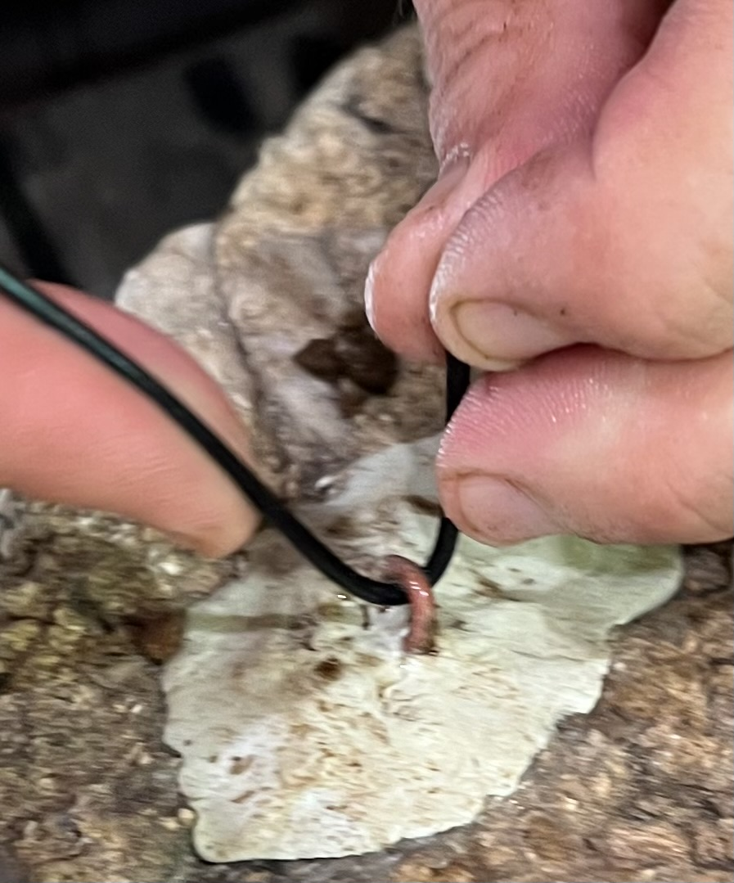
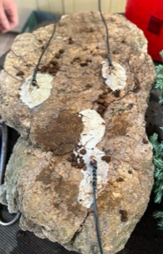
Installing Tie-Down Wires
Once the cement is dry, attach the tie-down wires to the 3 eye loops
The tie-down wires are ready to secure the rooted cuttings to the stone

Slide 11
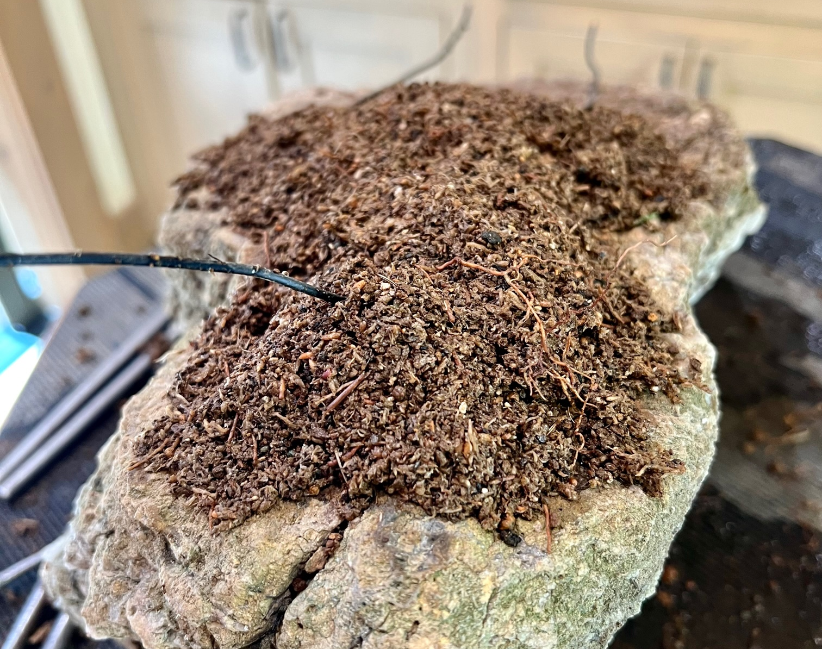
Adding Bottom Soil Layer
Screened akadama fines mixed with screened sphagnum moss

Slide 12
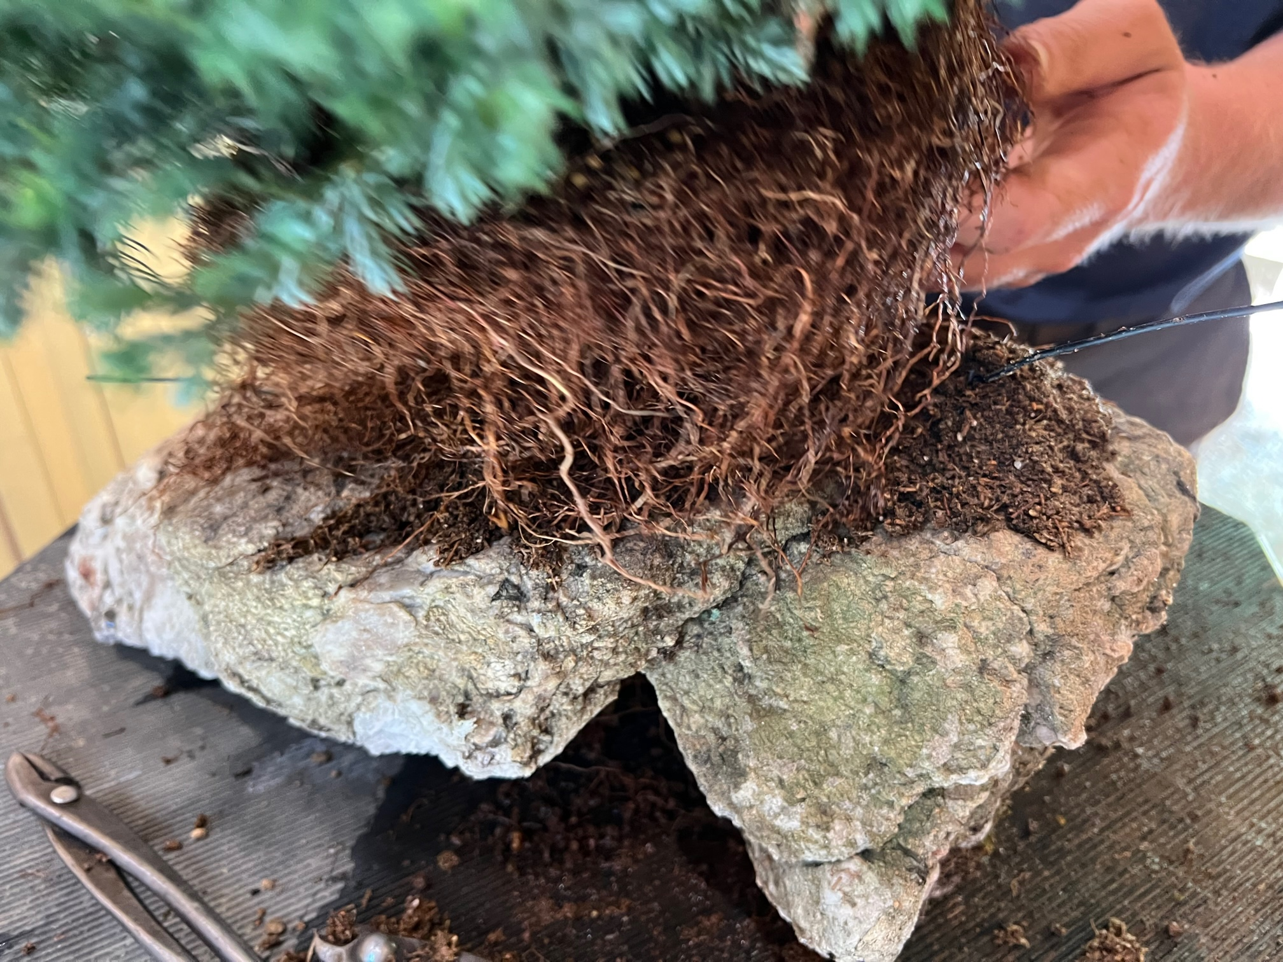
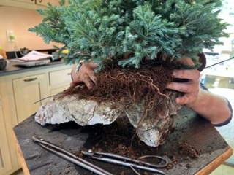
Placing Rooted Cuttings on Stone
Finding right location
Firming up placement

Slide 13
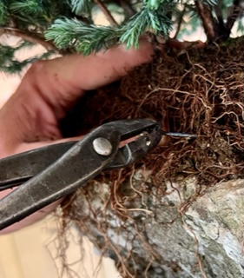
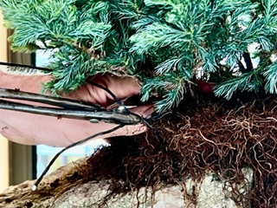
Connecting Tie-Down Wires
Twisting tie-down wires together
Tightening tie-down wires

Slide 14
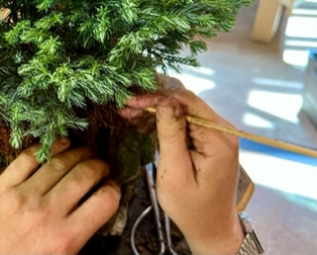
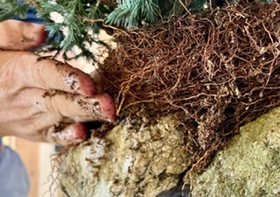
Inserting Akadama Mix
Pack akadama fines mixed with screened sphagnum moss into root mass
Use chopstick to push the fines/sphagnum between the roots

Slide 15
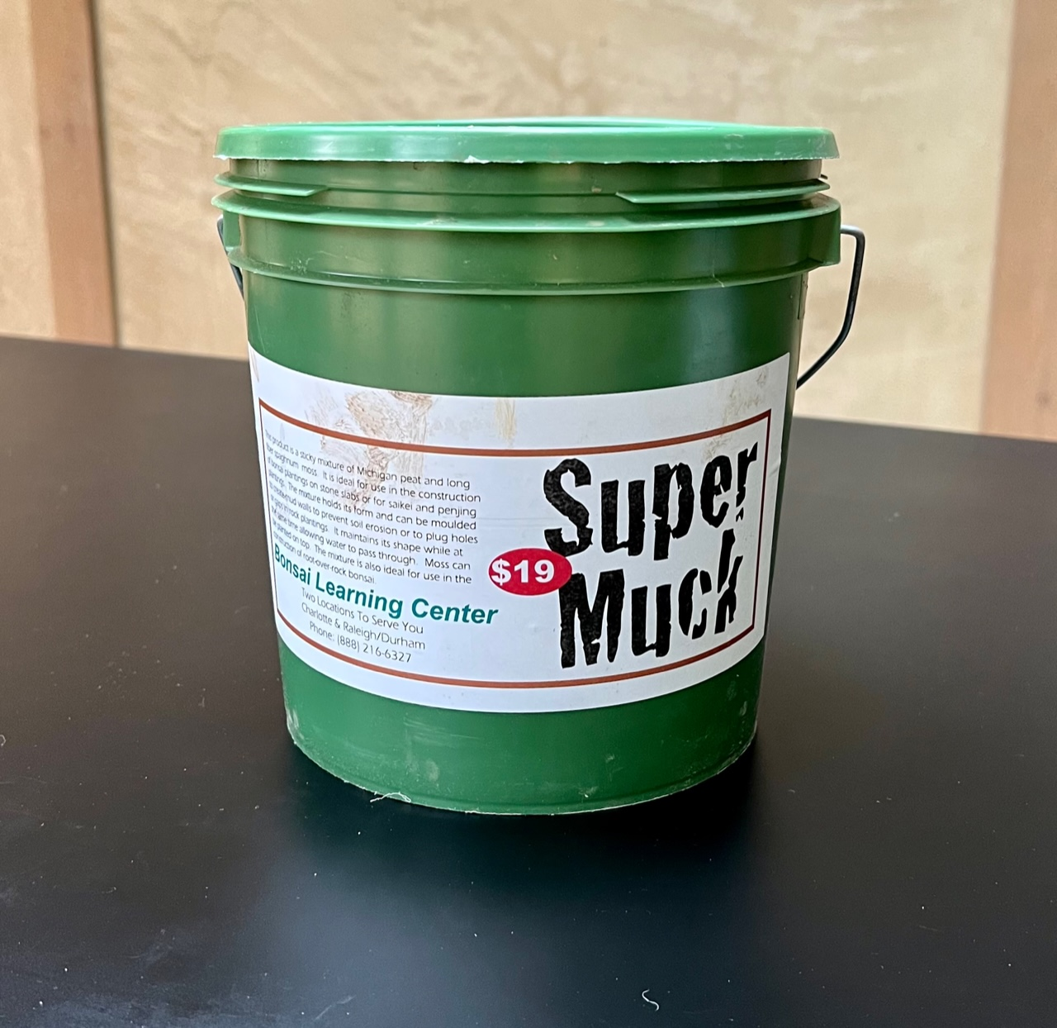
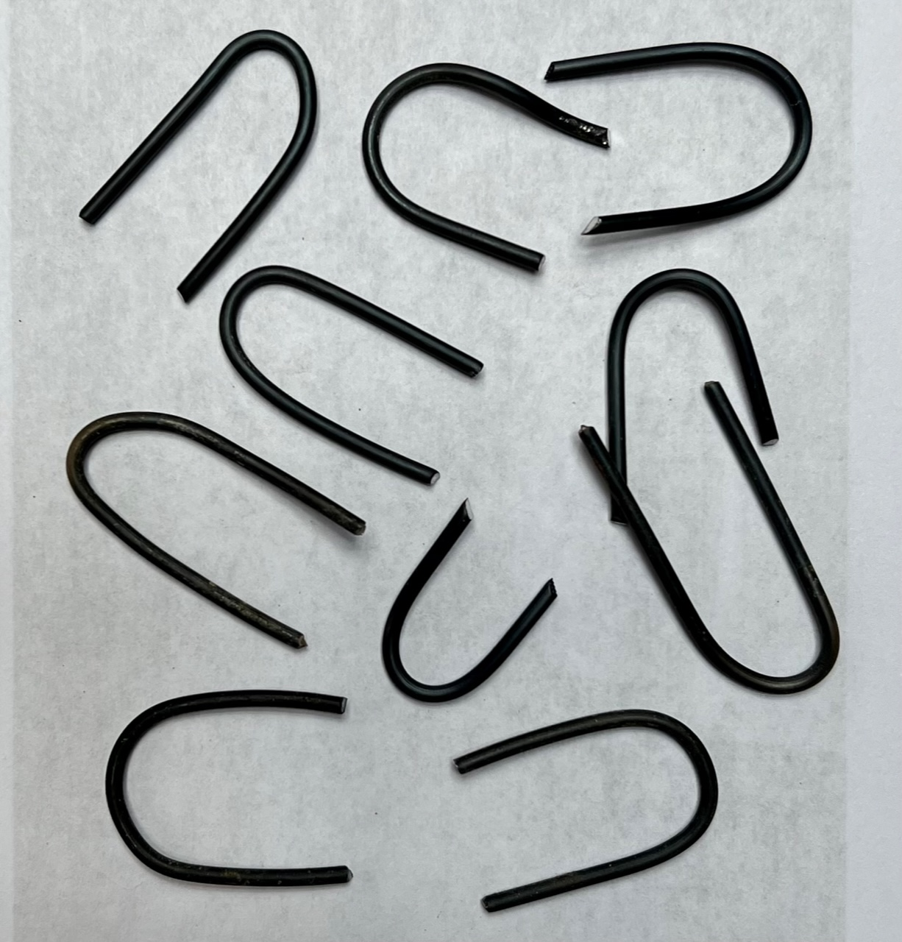
Muck and “Hair Pins”
Super Muck from
Bonsai Learning Center
Made from 2.0 mm aluminum
wire to pin moss in place

Slide 16
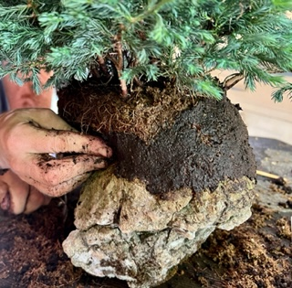
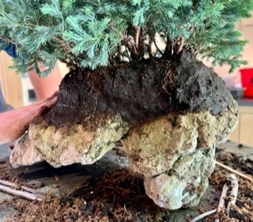
Building Muck Wall
Apply thin layer of moistened pure muck
Cover entire root ball with the muck

Slide 17
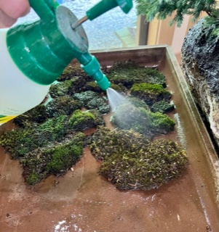
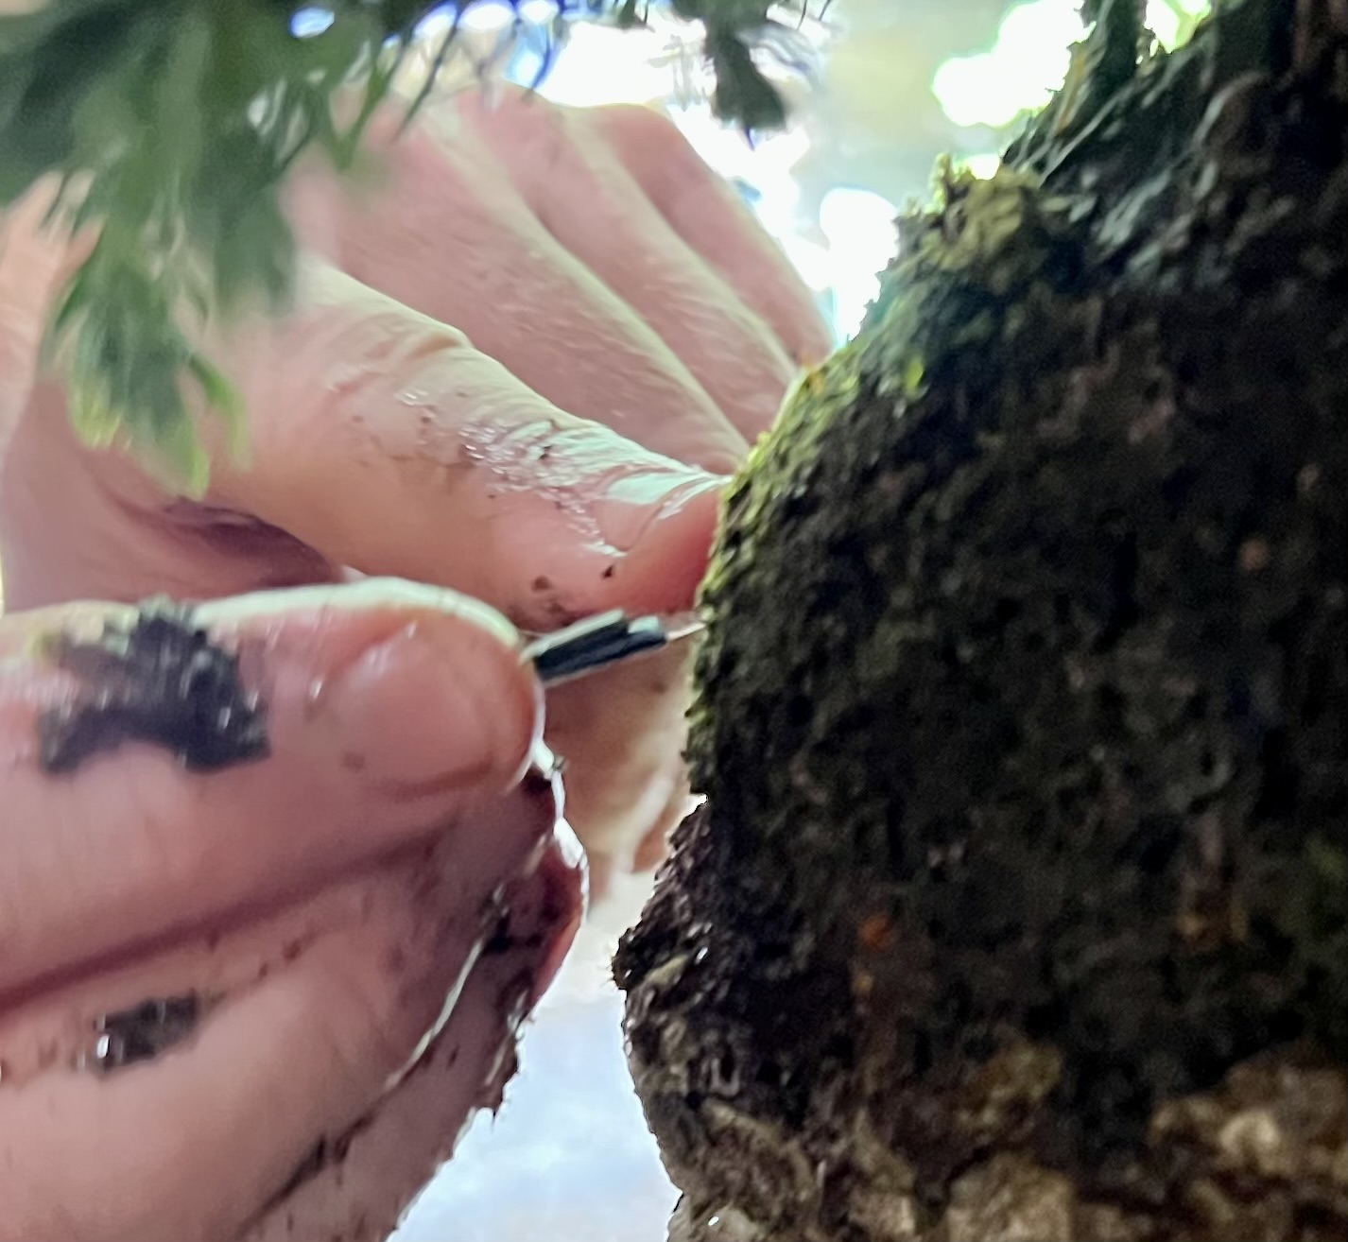
Applying Moss
Preparing collected moss
Pinning the moss in place

Slide 18
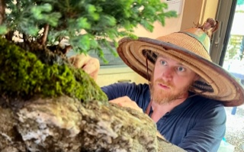
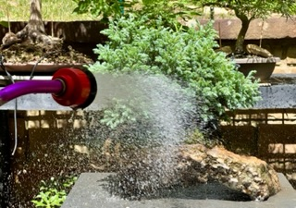
Finished For Now
Final inspection
Soft watering

Slide 19
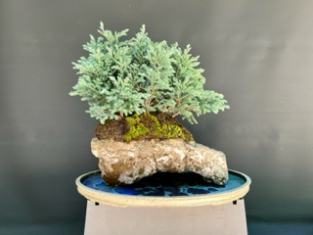
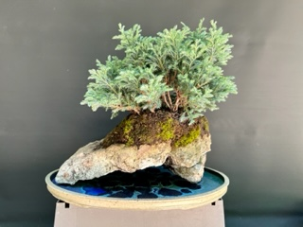
Plenty of Future Options
The cuttings will each be wired
An ancient forest will appear

