Slide 1
Creating Forest Bonsai
A Relatively Easy and Inexpensive Way to a Lifetime of Bonsai Enjoyment

Slide 2
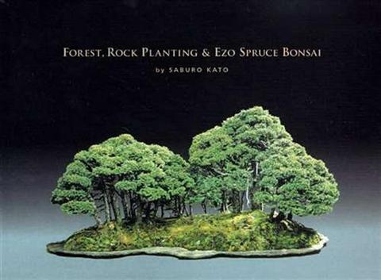
Forest, Rock Planting & Ezo Spruce Bonsai by Saburo Kato

Slide 3
The Remotest Hill
The forest planting shown on the cover of Saburo Kato’s book is one of his most well-known masterpieces called ”The Remotest Hill.”
All trees are Ezo Spruce (Piciea glehnii) collected by Mr. Kato in the 1930s from Kunashir Island, which is no longer a part of Japan. The main trunk is about 250 years old!
Mr. Kato worked on this forest for three years.

Slide 4
Saburo Kato with Forest Bonsai at Mansei-en

Slide 5
A 2001 Photo of Saburo Kato at Mansei-en

Slide 6
The Deeper Gift of Bonsai
The Japanese term “bonsai no kokoro” means the spirit of bonsai. Saburo Kato, who died at age 93 in 2008, was the Japanese bonsai master who probably explained this best:
“By nurturing a bonsai, we learn the essence and
dignity of life. In return for our care, the bonsai
portrays the ultimate beauty of nature, and our love
of the bonsai expands to encompass nature in all its
many forms.”

Slide 7
What is Needed for a Forest Bonsai?
“The materials for forest bonsai plantings do not need to be aged trees; instead, with enough effort, you can create something of beauty using seedlings, grafts, or layered materials.”
“Even lonely looking trees with just a trunk and a deficiency of branches can, properly arranged, be made into wonderful works of admiration.”
Saburo Kato, Forest, Rock Planting & Ezo Spruce Bonsai

Slide 8
Peace and Happiness
“The greatest enjoyment of bonsai is to be able to create something by yourself and to nurture it with love and affection.”
“A single [forest bonsai], made by yourself, can be sufficient to sooth the soul through the enjoyment of the morning and afternoon views , and your love of bonsai will deepen even more.”
“This is the beginning of peace and happiness.”
Saburo Kato, Forest, Rock Planting & Ezo Spruce Bonsai

Slide 9
Saburo Kato’s Forest at the 2017 World Bonsai Convention in Japan

Slide 10
John Y. Naka
‘Goshin’ – Perhaps the most famous bonsai in the world

Slide 11
Masahiko Kimura
One of the most creative forest plantings ever created

Slide 12
Basic Rules for Forest Plantings
Use uneven numbers of trees (unless more than 11).
Generally use trees of same species.
Use trees with varying trunk diameters
Determine Number 1, 2 and 3 trees. These will be planted first.

Slide 13
Basic Rules for Forest Plantings (cont’d)
Lay out all trees on a table in order of size.
Prune to make sure each tree’s height is proportionate to its trunk diameter.
For formal upright forest, wire any trees needing to be straightened.
When planting, try to avoid planting 3 trees in a straight line.

Slide 14
Kato’s Basic Forest Plan

Slide 15
Ways to Secure the Trees to the Pot or Slab
1. Wire from drainage holes (or drill new holes as needed in a training pot)
2. Wire using chopstick frame
3. Wire using the plastic webbed bottom of a nursery tray
4. Use “U”-shaped wire “hair” pins

Slide 16
Preparing to Plant using Chopsticks From Peter Warren’s book titled “Bonsai”

Slide 17
We Will Follow Kato’s Plan for a Deciduous Forest

Slide 18
The Planting Plan from Saburo Kato’s Book
We will
follow this Plan
as closely as
possible

Slide 19
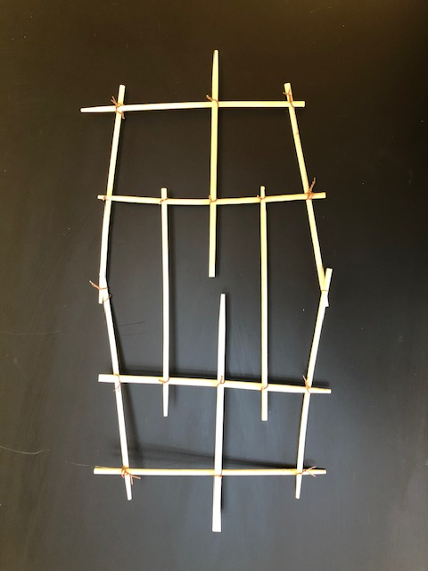
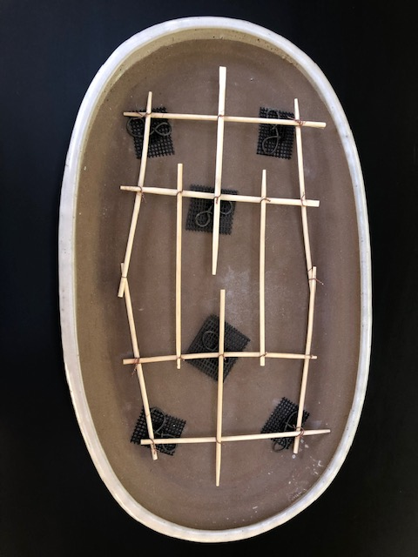
Chopstick Frame for Tie-Down Wires

Slide 20
Adding Tie-Down Wires
Aluminum Wire is
added to
Chopstick Frame
near
proposed location
of each Tree

Slide 21
Adding base layer of Soil Mix
Soil Mix is 1/3
Akadama,
Lava Rock and
Pumice.
Base Layer is
larger particles.

Slide 22
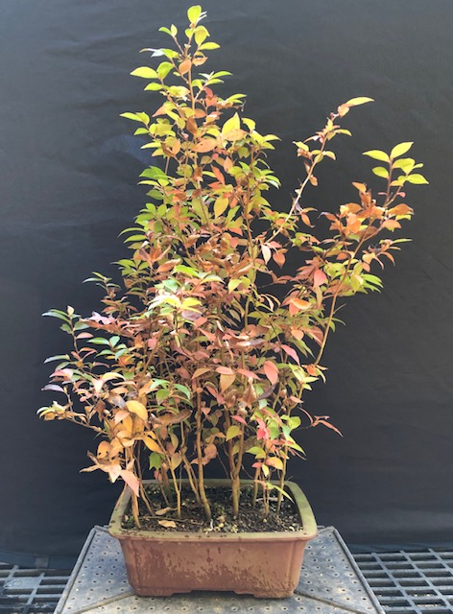
Stewartia Monadelpha
These are the trees to
be used to make this
new forest bonsai
Grown from Seed
by Sage Smith

Slide 23
Reducing Root Pad
Cutting off the
bottom half of the
root pad to make it
easier to separate
trees

Slide 24
Separating Trees
The trees are
separated and roots
are pruned.

Slide 25
Organizing Trees
Each tree is laid out
on a table
in order of
largest to smallest
Spray roots with water
frequently until they
are planted

Slide 26
Initial Planting of Trees
Starting with
Number 1 Tree
(largest), and securing
it with tie-down wire.
Next, plant and secure
Number 2 and
Number 3 Trees.

Slide 27
Adding Rest of the Trees
Trees are tied down
with wire and
more soil mix is
added.
Extra hands are
helpful.

Slide 28
Settling Soil Mix
Using chopsticks
to settle soil mix
around roots
and
avoid air pockets.

Slide 29
Finishing Touch
Adding screened
sphagnum moss
to prevent roots
from drying out.

Slide 30
Ready for First Watering
Watering will be
gentle to avoid
disturbing
moss
and soil mix.

Slide 31
The End
Waiting for Spring

