Slide 1
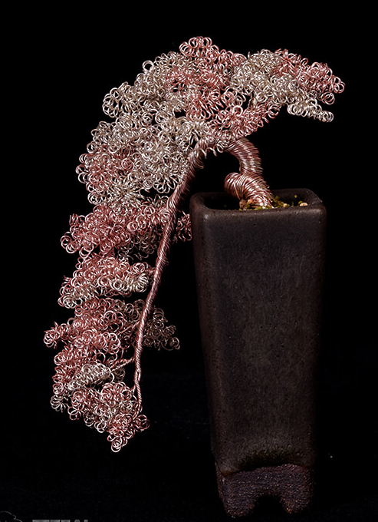
Excerpt from How to Do Fabulous Bonsai Wiring

Slide 2
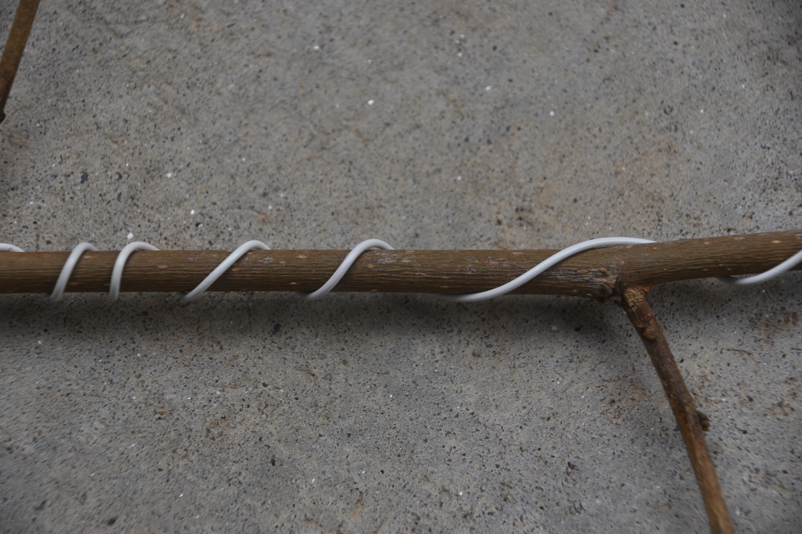
Angle of wire
45-60 degrees

Slide 3
Final loop: Bottom or top?

Slide 5
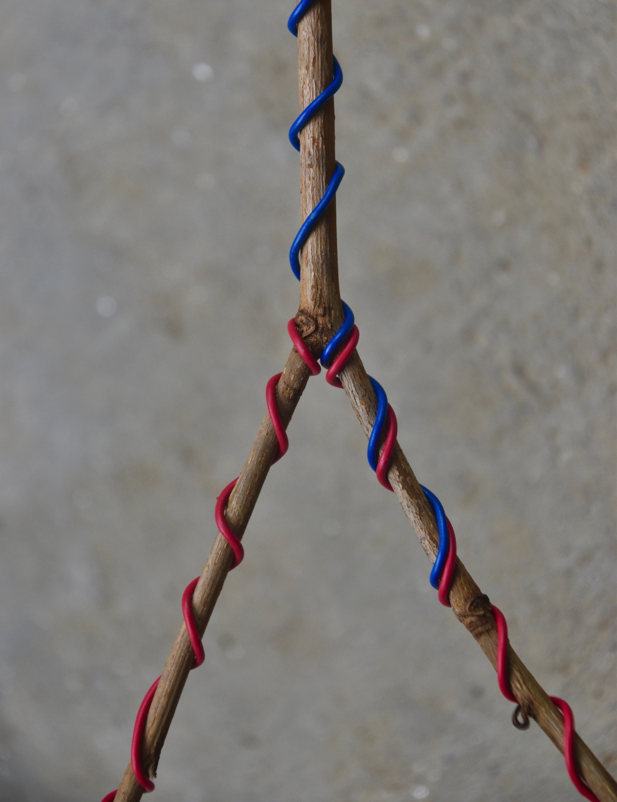
Anchoring

Slide 6
Teeter-totter branch

Slide 7
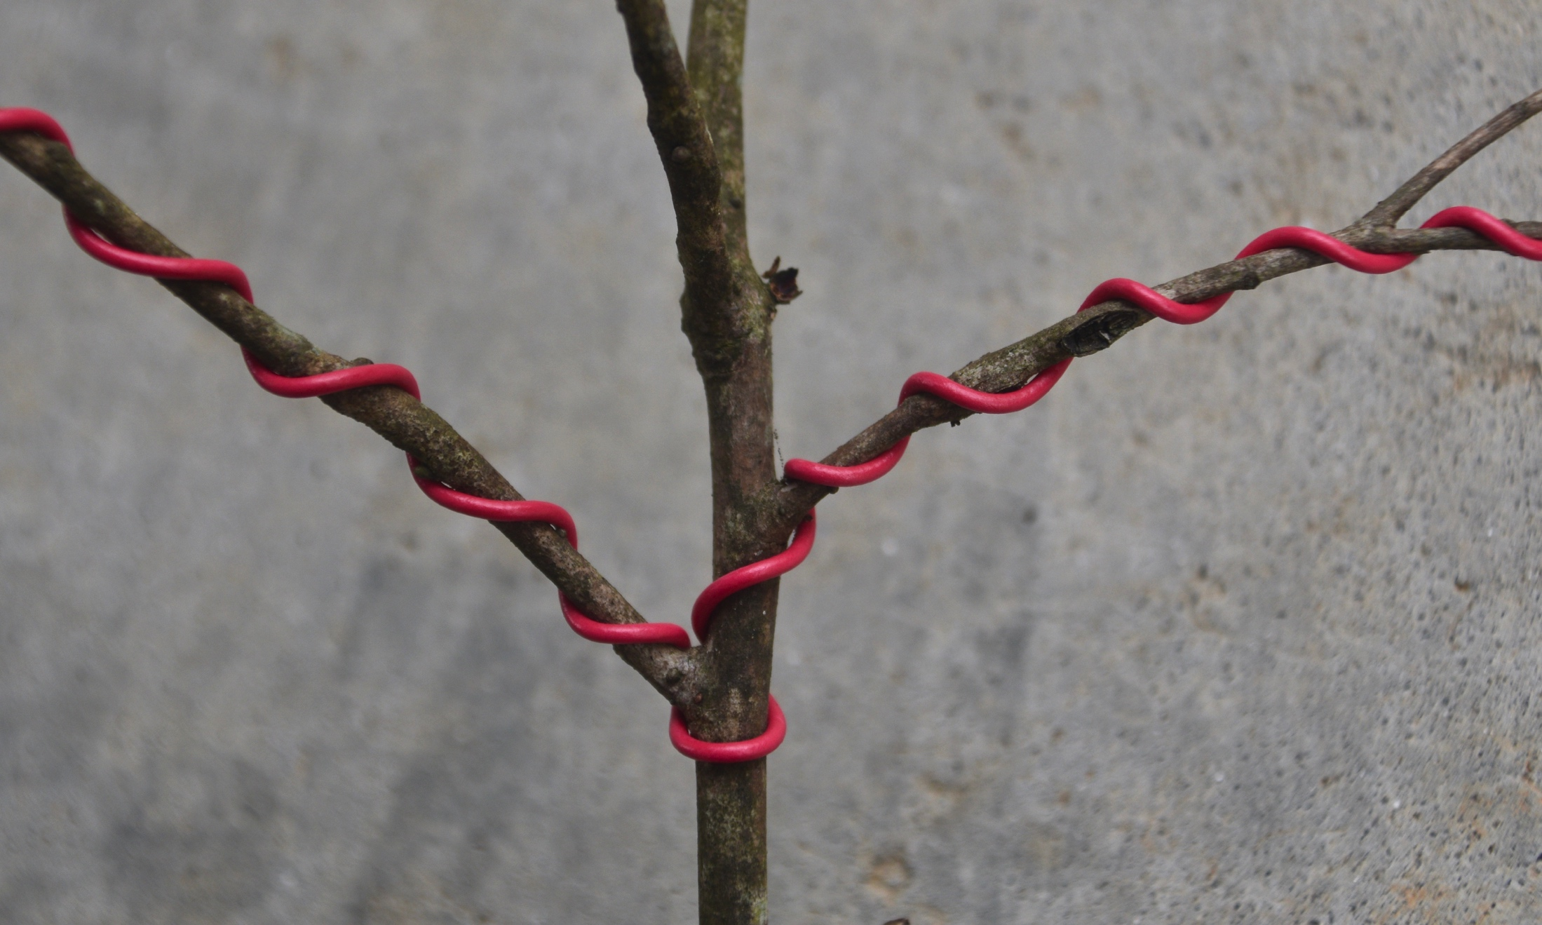
Another teeter-totter setup

Slide 8
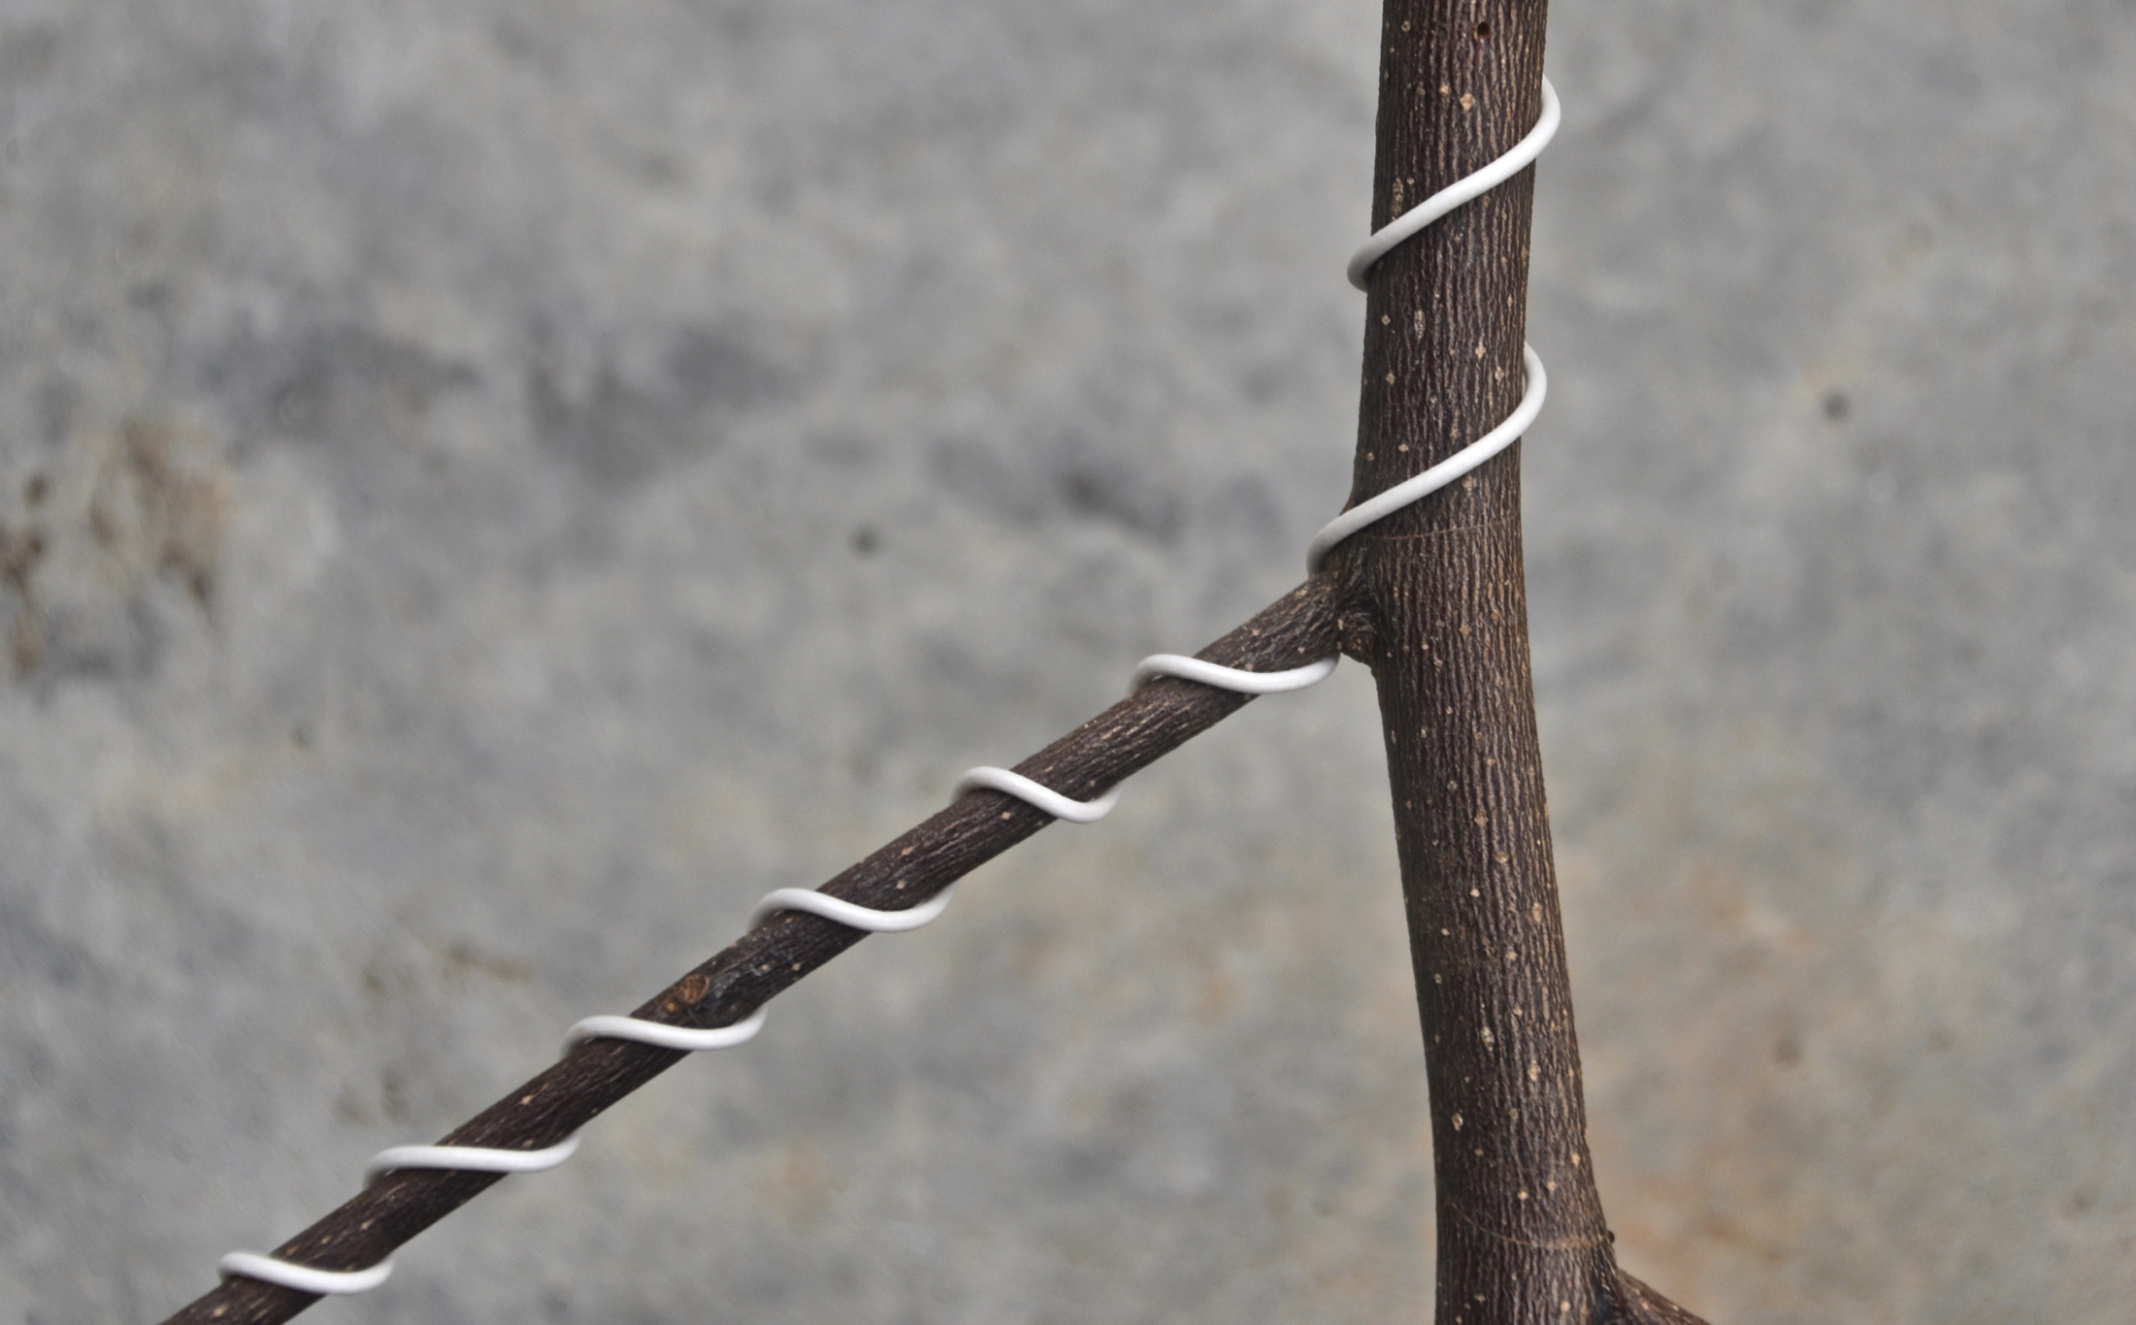
Basic Wiring Patterns
Wiring a single side branch

Slide 9
Wiring Two Branches with One Wire

Slide 10
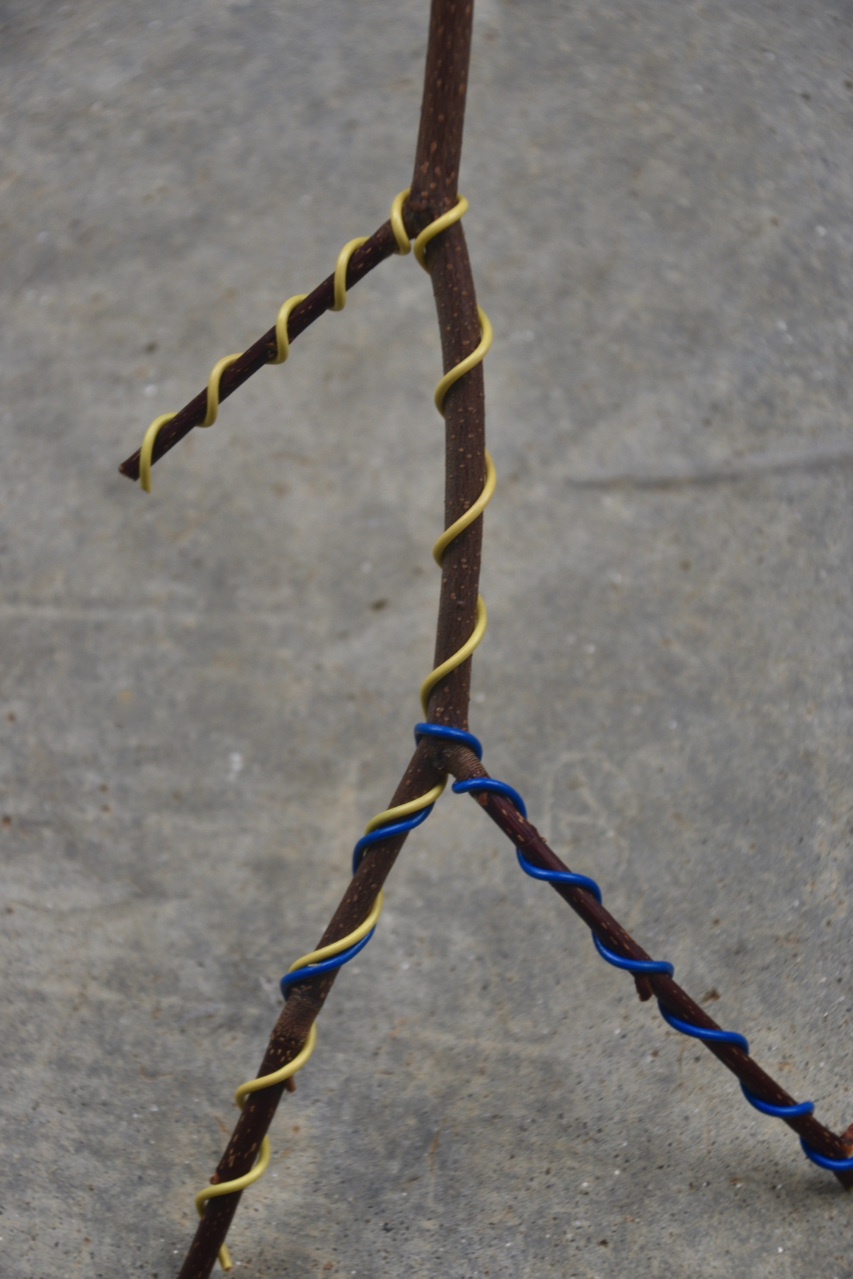
Adding another branch

Slide 11
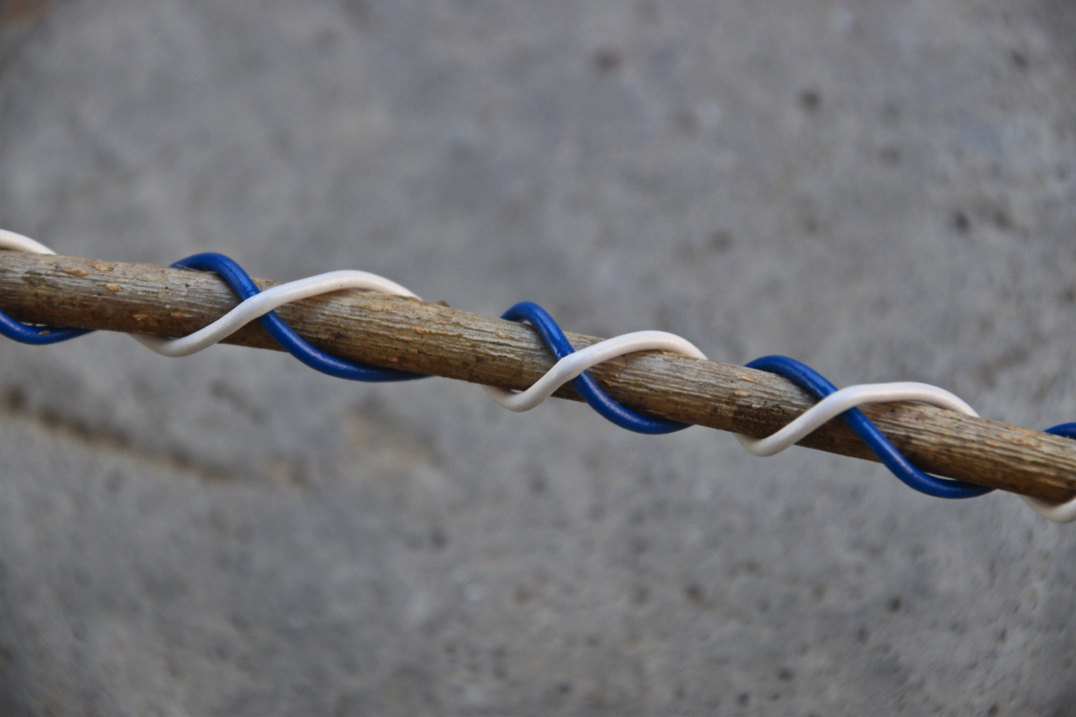
Crossing wires
OK

Slide 12
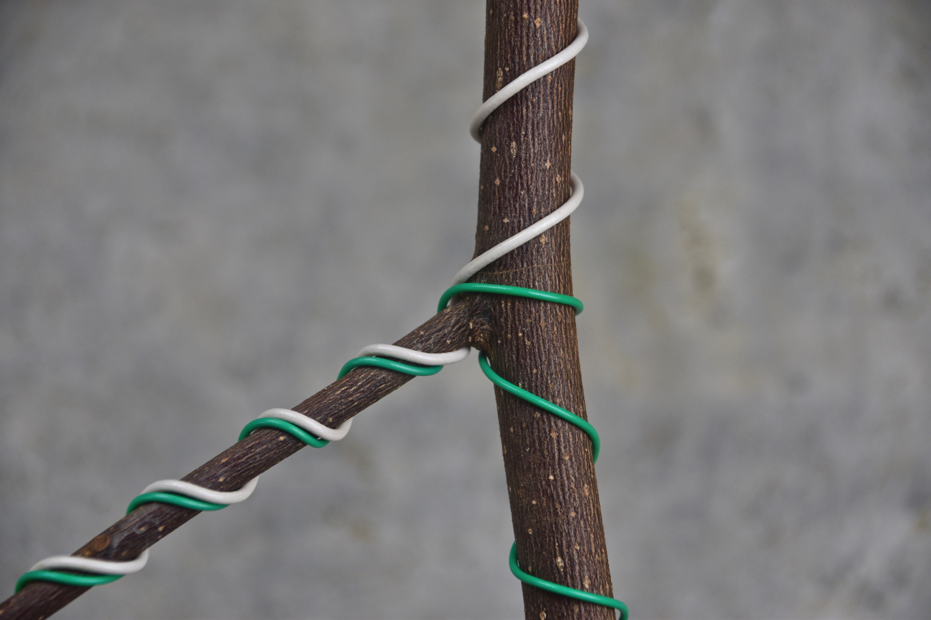
Correcting crossing wires

Slide 13
Special Cases: Twisted Branches Wiring a Damaged Branch

Slide 14
Approaching a Whole Branch

