Slide 1
BONSAI WINTER CARE & STORAGE
Presentation to the Blue Ridge Bonsai Society on February 21, 2021

Slide 2
TROPICAL BONSAI

Slide 3
Tropical Bonsai in Winter
1. Lighting: Even if placed in front of a south-facing window, most tropical bonsai need supplemental lighting.
2. Heat: Tropical bonsai should be in a warm spot in your house, but should never be subject to hot, dry forced air or radiant heating.
3. Humidity: Due to the dry nature of our heating, supplemental humidity should be provided. Use humidity trays or spray daily with a spray bottle.
4. Watering needs: Tropical trees tend to use less water in the winter. Over watering can cause root rot and a decline in tree health.
(Courtesy of Chris Baker, Chicago Botanic Garden Bonsai Curator)

Slide 4
Tropical Bonsai in Winter
Most tropical bonsai will not tolerate temperatures below 40°F to 45°F for any length of time.

Slide 5
Tropical Bonsai in Winter
When placed indoors, tropical trees need lots of light and relatively high humidity.
If possible, choose a spot immediately in front of a south-facing window to give the trees some sunlight.
(Photo credit: Chris Pazoles)

Slide 6
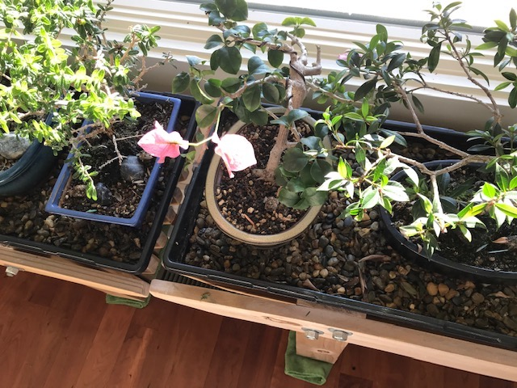
Tropical Bonsai in Winter
Use Humidity Trays to counteract dry air inside home.
(Photo credit: Chris Pazoles)

Slide 7
Tropical Bonsai in Winter
Ficus Nerifolia in front of south-facing window.
Elevated in black plastic tub used for mixing cement. Makes it easy to water and fertilize.
Fertilizing starts in January at half strength.
(Courtesy of Jim Hughes, former Curator of the National Bonsai & Penjing Museum and currently. Chairman of the National Bonsai Foundation.)

Slide 8
Tropical Bonsai in Winter
Another option is to add plant lights directly over the bonsai.
(Photo credit: Chicago Botanic Garden)

Slide 9
Tropical Bonsai in Winter
Ideal Sunporch for Tropical Bonsai!

Slide 10
WINTER PREPARATION Temperate Bonsai

Slide 11
Winter Prep -- Deciduous Trees
1. Remove old foliage. Done best with scissors and tweezers to prevent damage to the branches and next year’s buds.
2. Clean bases of the trunks, and remove moss/weeds from the soil surface. This prevents constant moisture from touching the trunks and allows better air circulation to the roots.
3. Pruning work. All cuts are covered with “cut paste” to seal the wound.
4. Tag for repotting. Tag those trees that need repotting in the spring.
(Courtesy of Chris Baker, Chicago Botanic Garden Bonsai Curator)

Slide 12
Remove Old Foliage (Photo credi: Chris Baker, Chicago Botanic Garden Bonsai Curator)

Slide 13
Remove Old Foliage (cont’d) (Photo credit: Chris Baker, Chicago Botanic Garden Bonsai Curator)

Slide 14
Remove Moss (Photo credit: Chris Baker, Chicago Botanic Garden Bonsai Curator)

Slide 15
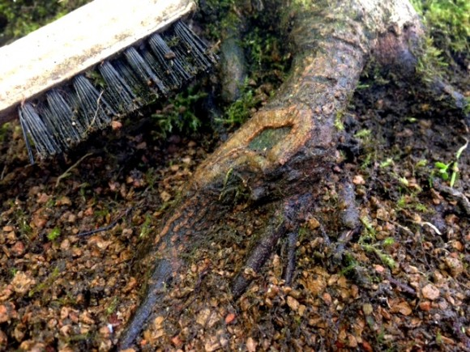
Clean Base of Trunks (Photo credit: Chris Baker, Chicago Botanic Garden Bonsai Curator)

Slide 16
Use Cut Paste on Big Cuts (Photo credit: Chris Baker, Chicago Botanic Garden Bonsai Curator)

Slide 17
Winter Prep -- Evergreen Trees
Remove old needles on the pines. This is also done with tweezers, and needles are pulled in the direction in which they grow to prevent damaging the branch.
Some light pruning is done as well as cleaning the surface of the soil.
Winter is a great time to do major work on pines like wiring, making big bends, and carving dead wood.
(Courtesy of Chris Baker, Chicago Botanic Garden Bonsai Curator)

Slide 18
Remove Old Needles on Pines (Photo credit: Chris Baker, Chicago Botanic Garden Bonsai Curator)

Slide 19
Lime Sulfur Spray
After foliage is removed from deciduous bonsai and before putting all bonsai in winter storage, spray them using Lime Sulfur (one part lime sulfur to 20 parts water).
Lime sulfur is both a fungicide and an insecticide, treating many fungal diseases and controlling overwintering insects.
In 2008, the EPA questioned whether lime sulfur, which can cause irreversible eye damage, should be available to homeowners, so it is hard to find. Protect yourself, valuable pots and soil surface from spray.

Slide 20
COLD ACCLIMATION & DORMANCY

Slide 21
Asheville Hardiness Zone = 7a

Slide 22
What Does the USDA Map Mean?
The USDA map is a good starting point when you're trying to decide what plants to grow in the ground in the Asheville area.
Here in Zone 7a, the average annual extreme minimum temperature is 0°F to 5°F. Winters only occasionally hit the negatives in this zone.
So plants that are rated to be hardy in Zone 7a should, if planted in the ground, be able to withstand temperatures of 0°F to 5°F.

Slide 23
Above-Ground Cold Hardiness Bell Curve
DeHayes, Donald H.; Schaberg, Paul G.; Strimbeck, G.Richard. 2001. Red spruce (Picea rubens Sarg.) cold hardiness and freezing injury susceptibility Chapter 18. In: Bigras, F.; Columbo, S.J., eds. Conifer cold hardiness: 495-529, at 502.

Slide 24
Cold Acclimation for Temperate Bonsai
By November, temperate trees are already preparing for the coming winter by hardening up and acclimating new growth and, for deciduous trees, dropping leaves to reduce moisture loss.
Temperate trees need to be exposed to cold weather in the fall in order to enter dormancy.
So for most tree species, wait until the first frost before putting your trees in winter storage or adding protection.

Slide 25
Signs of Cold Acclimation

Slide 26
Cold Acclimation
First frost December 2020:
Hinoki Cypress ready for winter storage

Slide 27
Dormancy
Cold Hardening Triggers. Exposure to short days, low temperatures and (very importantly) frost induces the bonsai to begin "cold hardening" to sustain it from the coming winter temperatures.
Chilling Requirement. Temperate bonsai need to undergo a period of chilling to be rested and ready to break dormancy and start regrowth. This period has been defined as 33°-50°F for a period of 4-6 weeks. Time spent at below-freezing temperatures is not counted, and temperatures above 60°F degrees are detrimental to chilling.
Roots of temperate bonsai do not "cold harden" like the above-ground parts and are much more sensitive to low temperatures and can be more easily damaged.

Slide 28
KILLING TEMERATURES

Slide 29
Winter Goal for Bonsai Roots: Avoid “Killing Temperatures”
For us, this goal is typically accomplished by one of the following means (in order of decreasing effectiveness):
Keeping the bonsai in a temperature-controlled greenhouse.
Keeping the bonsai in a cold frame, unheated garage, etc.
Bury the bonsai in a gravel bed or in the ground.
Placing the bonsai on the ground surrounded by mulch.
Wrapping pots with frost blankets or bed sheets on cold days and nights.

Slide 30
Fatal if within a Bonsai’s Cells
Killing Temperatures are those that result in the formation of ice crystals inside the cells of a bonsai.

Slide 31
Three Stages of Freezing in a Bonsai Pot
If a bonsai truly freezes, it dies. The formation of ice within the cells of a bonsai is invariably fatal. But when you see frozen soil in a bonsai container, this does not necessarily mean the cells of the bonsai’s roots are frozen.
There are basically three stages of freezing that can occur in a bonsai pot:
The freezing of the water in the bonsai's soil (this freezes first and occurs when the temperature drops to or below 32°F)
The freezing of inter-cellular water in between the bonsai’s cells (this freezes second, as temperature drops further) .
The freezing of intra-cellular water inside the bonsai’s cells (this freezes last, when it gets really cold) .
Courtesy of Freeze Damage in Woody Plants, by Andy Walsh (found at https://www.evergreengardenworks.com/frzekill.htm.)

Slide 32
Freezing in a Bonsai Pot
In which stage of freezing is “Goshin”?

Slide 33
Freezing of Water in the Soil
This first stage of freezing occurs at the highest freezing temperature (e.g., at or just below 32°F). At this point, the water in the soil is frozen but NOT the roots or the branches and stems of the bonsai.
The roots and stems have several mechanisms to avoid ice formation within their cells. One is called “freezing-point depression” in which the presence of sugars, etc. in the water inside the cells lowers the freezing point of the water and keeps those cells from freezing when the temperature falls below 32° F. (Like salting roads in winter to prevent ice formation.)

Slide 34
Freezing of Water in the Soil (cont’d)
If the temperature goes back up but the soil water remains frozen, transpiration of water can occur from the stems without their ability to draw up water from the frozen soil.
This results in desiccation, or "winter dieback," of shoots and branches.
Winter dieback is best avoided through some form of windbreak.

Slide 35
Freezing of Inter-cellular Water
This is the second stage of freezing within the bonsai pot. Here the cells within the roots and stems employ another mechanism to avoid freezing.
This is called “dehydration by ice segregation” in which the bonsai’s roots and above-ground parts expel water from their cells into the spaces between the cells. The water then freezes there instead of within the cell.

Slide 36
Freezing of Intra-cellular Water
The third stage and most lethal is when the water inside the cells freezes.
One freeze-avoidance mechanism that plants use at this level is called "supercooling". The water within the cell becomes so pure that it remains liquid at temperatures well below its normal freezing point.
Supercooling Illustration: Put a bottle of tap water and a bottle of distilled water in the freezer. Once the tap water freezes, you will see that the distilled water has not yet frozen, as it is “supercooled.”

Slide 37
Root v. Top Hardiness
The tree hardiness ratings you find in books and online are for the top, or above-ground, part of the tree – trunk, branches and foliage, not the roots.
The roots are far less hardy than the top of a tree, so relying on tree hardiness ratings can be lethal to your bonsai.
Example: Pinus sylvestris (Scots pine) has a top hardiness rating of -50°F and a root rating of 10°F – a difference of 60°F!

Slide 38
Bonsai Root Kill Temperatures (F) (Full List in Michael Hagedorn’s Bonsai Heresy, pp.87-89)

Slide 39
Root Ratings Key Takeaways
Don’t be misled by above-ground hardiness ratings and kill your bonsai in winter.
The Root Kill List shows minimum root temperatures, not optimum temps.
Joe Harris, a bonsai expert at Isely Nursery, says:
Treat 18°F as minimum for very-hardy bonsai.
Treat 23°F as minimum for all the less-hardy bonsai.

Slide 40
WINTER PROTECTION

Slide 41
Bonsai Most Susceptible to Cold Damage
Small- and medium-sized bonsai
Recently-repotted or recently-pruned (less foliar mass) bonsai
More refined bonsai (many small twigs)
Less hardy species

Slide 42
Easiest Way to Winter-Protect Bonsai
Place pots on ground –
7°F -10°F warmer than air temperature
Heel-in (up to rim of pots) with mulch, leaves, frost blanket
Protect from wind
Beware of rodent activity

Slide 43
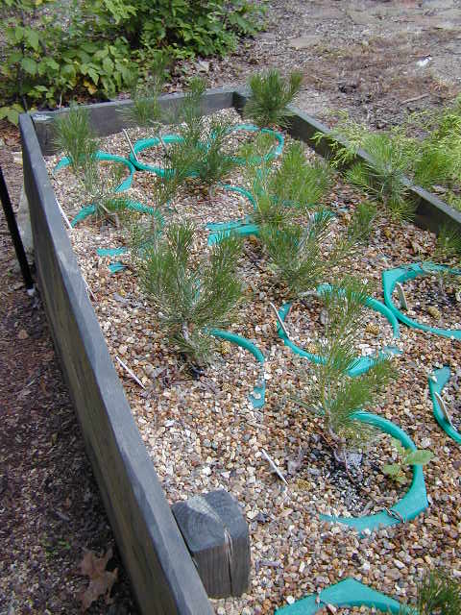
Raised Gravel Beds

Slide 44
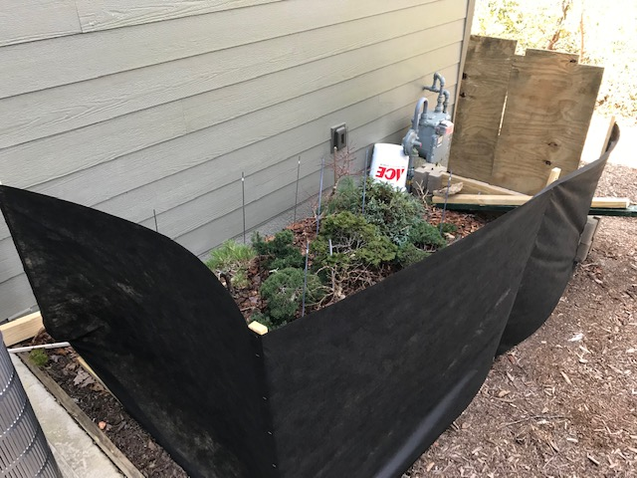
Winter Protection (Photo credit: Chris Pazoles)

Slide 45
Winter Protection
Heeled-in with Mulch (courtesy Bonsai Learning Center)
Wind Protection Frost Blanket over Table

Slide 46
Winter Protection

Slide 47
Conveyer-Belt Winter Protection
Only a surgeon would think of this approach
Whenever the temperature will be below freezing, he simply rolls the bonsai-laden shelves into the unheated garage and out again into the fresh air when it goes above freezing.

Slide 48
Makeshift Greenhouse

Slide 49
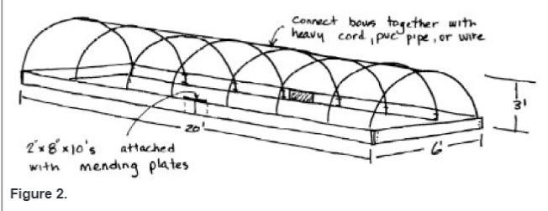
Instructions from NC State Extension, including materials, tools, and costs, for building
Inexpensive winter protection: https://content.ces.ncsu.edu/static/publication/js/pdf_js/web/viewer.html?slug=low-investment-propagationwinter-protection-structure
or
A small greenhouse: https://content.ces.ncsu.edu/a-small-backyard-greenhouse-for-the-home-gardener

Slide 50
Protecting Large Hardy Bonsai
Mulch Bag Protection
Happy in the Snow

Slide 51
Beware of Rodent Damage
Mice and other rodents can kill your bonsai while in winter storage by eating the bark around the trunks of your bonsai.
This is a particular problem for bonsai stored with their pots on the ground.

Slide 52
Something Else to Worry About!
“Mom will probably tell you about my bonsai disaster. The mice (voles?) chewed up maybe a third of my outdoor bonsai. Some are girdled around the base and others look like driftwood – all cambium gone, as if eaten by small beavers.”
Bonsai Heresy at p. 70 (Michael Hagedorn’s message to his father early in his bonsai career).

Slide 53
Protection against Rodents
I had a serious rodent problem when I lived in Virginia and had to wrap the trunks of all my bonsai over winter with wire mesh (Aluminum Gutter Guard 6” x 20 ft.)
If this happens to your bonsai, Bill Valavanis has a solution: layer the damaged tree. See “Repairing Rodent Damaged Bonsai,” by Bill Valavanis, found at: https://valavanisbonsaiblog.com/2018/03/25/repairing-rodent-damaged-bonsai/

Slide 54
NEED FOR LIGHT IN DORMANCY

Slide 55
Do Bonsai Need Light in Winter?
Once deciduous trees have dropped their leaves and evergreen trees have experienced a frost, they will have minimal need for light.
Indeed, once fully dormant, there are at least two famous public bonsai collections where the bonsai – including evergreens -- are kept in complete darkness over winter:
The Arnold Arboretum Larz Anderson Bonsai Collection
The North Carolina Arboretum (TNCA) Bonsai Exhibition Garden

Slide 56
Krummholz Trees

Slide 57
Larz Anderson Bonsai Collection
The bonsai at the Larz Anderson Bonsai Collection at the Arnold Arboretum at Harvard University were brought to the United States in 1913 by Larz Anderson after serving as US ambassador to Japan.
This is the oldest collection of bonsai in the United States.
During winter months, the bonsai in that collection are stored in complete darkness in a concrete-block structure that is evenly maintained at 33 to 36 degrees Fahrenheit.

Slide 58
Larz Anderson Bonsai Collection (cont’d)
The trees must be fully dormant before they go into storage in November and are checked for water once a week until they emerge in April.

Slide 59
TNCA Bonsai Exhibition Garden
Here at the North Carolina Arboretum, Curator Arthur Joura has two different locations where he keeps the evergreen and deciduous bonsai in the winter.
One is located in a large, walk-in refrigeration unit in the basement of the Bonsai Exhibition Garden pavilion.
The other is a hoop house structure that is covered with white polypropylene to protect the plants from the extremes of winter weather, which also allows them to still be cold and go dormant.

Slide 60
TNCA Bonsai Exhibition Garden
The winter storage area is underneath the Pavilion.
The bonsai are fully dormant when placed in this space which is completely dark.

Slide 61
Protecting Pots and Roots

Slide 62
During Overwintering
Keep a close eye on your bonsai.
Look ahead each week to be aware of upcoming temperature estimates.
Use a max-min thermometer to monitor ambient temperature.
Water as needed.
Check for insects, disease and critters regularly.
Be sure there is no overhead fan or other reason for the soil to dry out too quickly.

Slide 63
Deacclimation and New Growth
With warmer temperatures in spring, bonsai lose their hardiness, or freeze-tolerance, acquired during acclimation.
This process is called dehardening, or deacclimation, and occurs while the bonsai resume growth and development.
During deacclimation, the bonsai’s cells and tissues are rehydrated. If cold weather returns, this high-water content may result in severe damage due to ice formation within the bonsai’s cells and tissues.

Slide 64
Deacclimation: Most Dangerous Time of the Year?
April 25 is supposed to be the last expected frost date in our area.
But, due to climate change, we are having more erratic temperature fluctuations, which could render deacclimated bonsai more vulnerable to freeze-damage.
During many springs this century, we have had devastating killer-frosts across North America.
So we must be very careful in the spring, when bonsai are losing their hardiness and beginning to grow. Even very hardy bonsai can be damaged by cold. Such cold damage is irreversible.

Slide 65
THANK YOU!
And Good Luck with Your Bonsai in 2021!

Slide 66
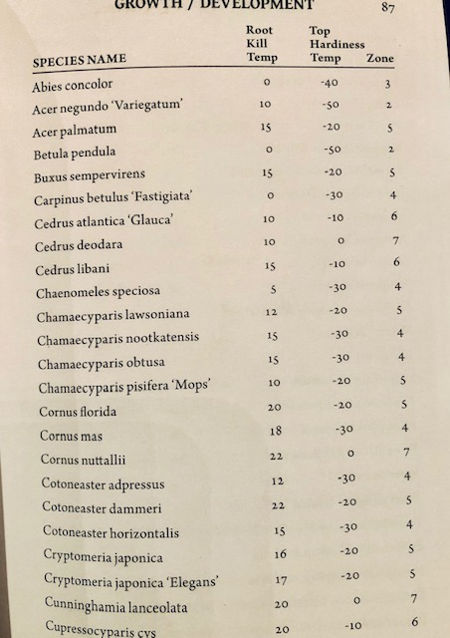

Slide 67
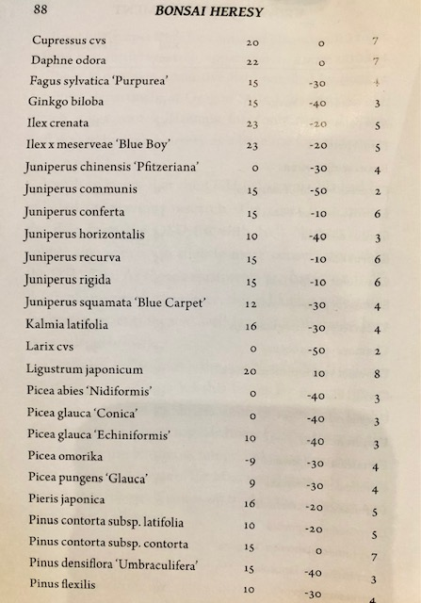

Slide 68
